Slide 1
Monthly developers' meeting
September 2024

Slide 2
GitHub data: ….

Slide 3
Agenda
https://github.com/orgs/gem5/discussions/1503
Always available on https://github.com/orgs/gem5/discussions
configs,tests: Deprecate "configs/common" #1498 [Bobby/Jason]
prebuilt boards: What are they meant for? Add arm demo board #1478 [Jason]
misc,github,tests: Remove gerrit change ID requirement #1486 [Bobby/Jason]
ARM: Pair Memory Instructions Microops #1545 [Mahyar Samani]

Slide 4
Demo boards
Long-term goal: “Known-good configurations”
Want gem5 standard library boards which match (some) real hardware
This is *hard* but we are actively working on it
What these “prebuilt” boards are not
Not configurable, not parameterized, not extensible, not for everything
Until then: Need prebuilt boards that are fixed
Goal: Show that workloads/suites run
Used to build infrastructure for future known-good boards

Slide 5
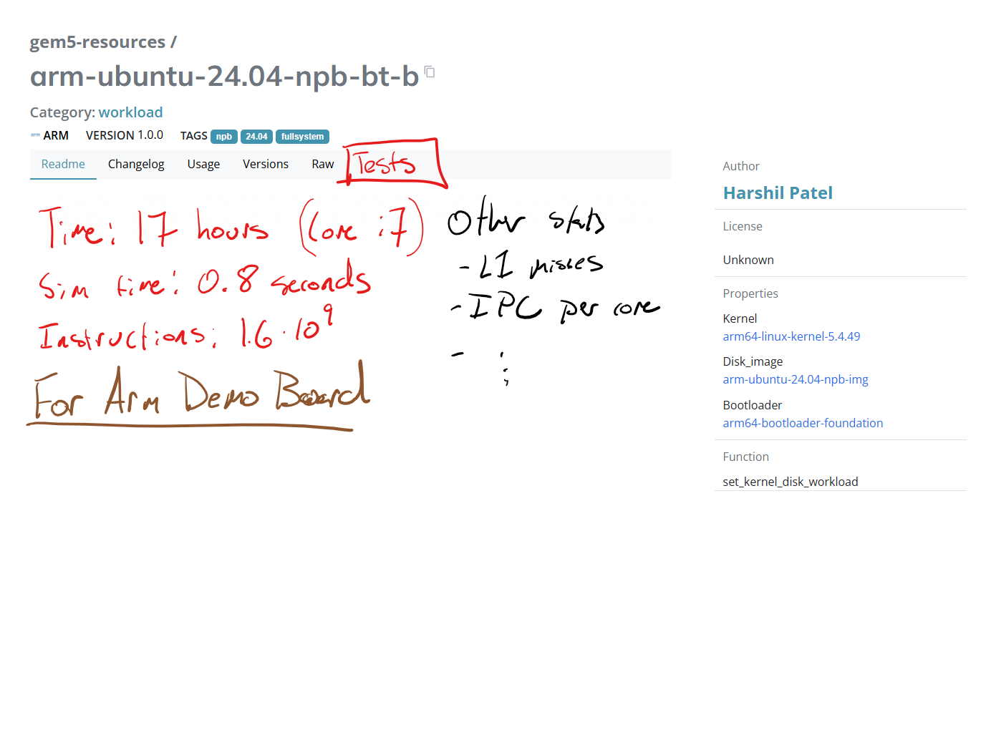
Goal

Slide 6
Other cool ideas
See https://github.com/orgs/gem5/discussions/754
Dashboard for current running workloads
We know the total insts and how many we’ve executed so far: Can predict time left
Quickly know if something is broken
See what’s tested and what’s not tested
See if the results are reasonable for your use case

Slide 7
Deprecating configs/common
https://github.com/gem5/gem5/pull/1498
Jason’s rant: The interface to gem5 is not command line parameters and should not be
I admit we need discoverability of parameters and a good interface to change them
Why deprecate?
Maintenance nightmare. Options.py is incredibly misleading and leads to bad research
While it’s there people will keep using it
Blockers
Arm FS tests
Configs/example/arm
Configs/example/apu_se.py, configs/gpufs

Slide 8
Blockers
Arm FS tests
Relatively straightforward to update in tests/gem5/configs?
Configs/example/arm
Much less straightforward to update
cores/arm/O3_ARM_v7a.py etc. are useful
Convert to standard library? What do we lose? Can we regain it?
Configs/example/apu_se.py, configs/gpufs
apu_se.py deprecate? Requires difficult docker setup, uses old GPU architecture.
GPUFS: Migrate to stdlib? What do we lose? Can we regain it?

Slide 9
Change_id
Are there any blockers to misc,github,tests: Remove gerrit change ID requirement by BobbyRBruce · Pull Request #1486 · gem5/gem5
There are no reviews

Slide 10
Arm paired memory ops
Background
Working to develop known-good configuration for Arm systems (Ampere Altra)
(Why this one? Because it’s what we have ☺)
See darchr/novoverse: A set of configurations to model Arm's N1 cores. (github.com)
tl;dr
Discrepancy in hw counters for number of cache accesses and number of stores
Paired memory instructions match with discrepancy

Slide 11
ARM ISA microops
gem5 Developers Meeting
Mahyar Samani

Slide 12
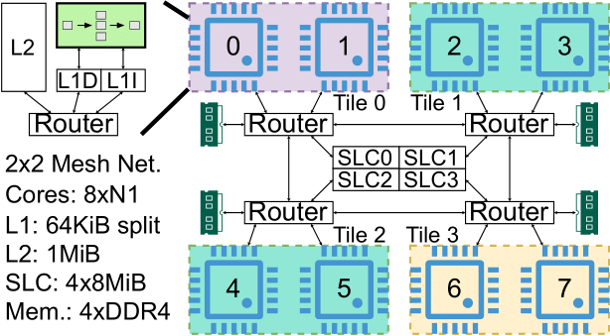
A little bit of context
Objective: Model HPC Platform based on Neoverse N1 in gem5
N1 core from Bine Brank
CMN Model using CHI
Use samples of execution in NAS Parallel Benchmark for comparison
Use stats in gem5
Use PAPI on real hardware

Slide 13
What we see
gem5 can differ from real hardware:
From 1.6x faster to 6.6x slower.
From 1x to 1.6x more data cache accesses. ($dcache_{gem5},dcache_{native})$
From 1x to 4x more store instructions committed:
on gem5: number of microops committed ($store_{gem5})$
on PAPI: “PAPI_SR_INS” (could be macroops/microops) ($store_{native})$
From 1x to 1.5x more load instructions committed. ($load_{gem5}, load_{native})$
Correlations
Error in number of cycles is highly correlated to the error in number of data cache accesses.
Error in data cache accesses is mostly explained by error in number of load and store instructions.

Slide 14
Explainability of Data Cache Access Error
Population of Samples
Error in dcache accesses
Error in load
Error in store
$$\frac{{(dcache}_{gem5}−{dcache}_{native}) −({load}_{gem5}−{load}_{native}) −(store_{gem5}−store_{native})}{(dcache_{gem5}−dcache_{native})}$$
Portion of error in dcache accesses not explained by error in memory instructions

Slide 15
Explainability of Data Cache Access Error
Population of Samples
$$\frac{{(dcache}_{gem5}−{dcache}_{native}) −({load}_{gem5}−{load}_{native}) −(store_{gem5}−store_{native})}{(dcache_{gem5}−dcache_{native})}$$

Slide 16
Deeper Look
Semi-Randomly selected samples.
ft-4 has the lowest error in data cache accesses as well as store instructions.
ft-127 has the highest error in data cache accesses as well as store instructions.
Others randomly selected

Slide 17
#store: gem5 vs native

Slide 18
Discussion
We see that the error in data cache accesses is correlated and explainable by our definition of error in number of load and specially store instructions.
We deeply investigated the commit trace of the semi-randomly selected samples and think the root cause is how PairMemOps are translated to microops in gem5.
What is the right path to correcting this? Is there a limitation in Ruby/RubySequencer that prevents us from creating one microop for each PairMemOp?

